Slide 1


School of Engineering Technology and Applied Science
API Engineering
Reza Dibaj

Slide 2
ASP.NET Core Authentication

Slide 3
Identity on ASP.NET Core
ASP.NET Core Identity is a membership system to allow login functionality be added to our application:
Users can create an account and login with a user name and password
User can login by using an external login provider such as Facebook, Google, Microsoft account, Twitter or others

Slide 4
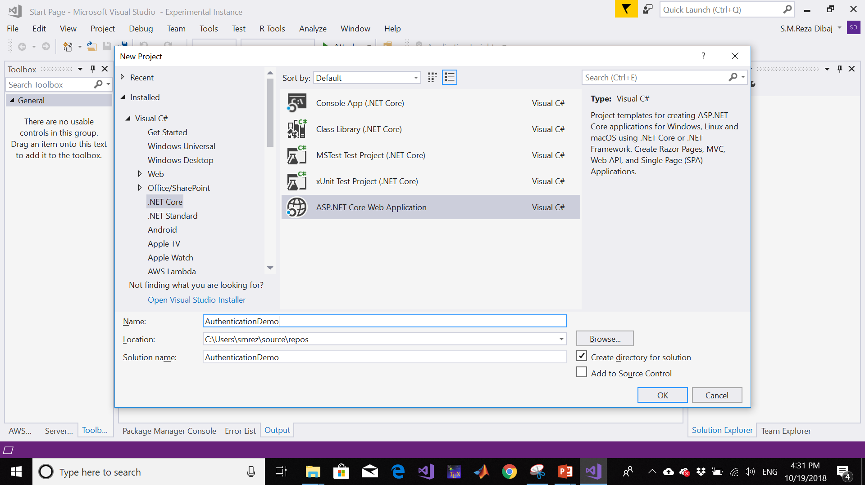
Implementation of ASP.NET Core Web Application
Creating a new project…

Slide 5
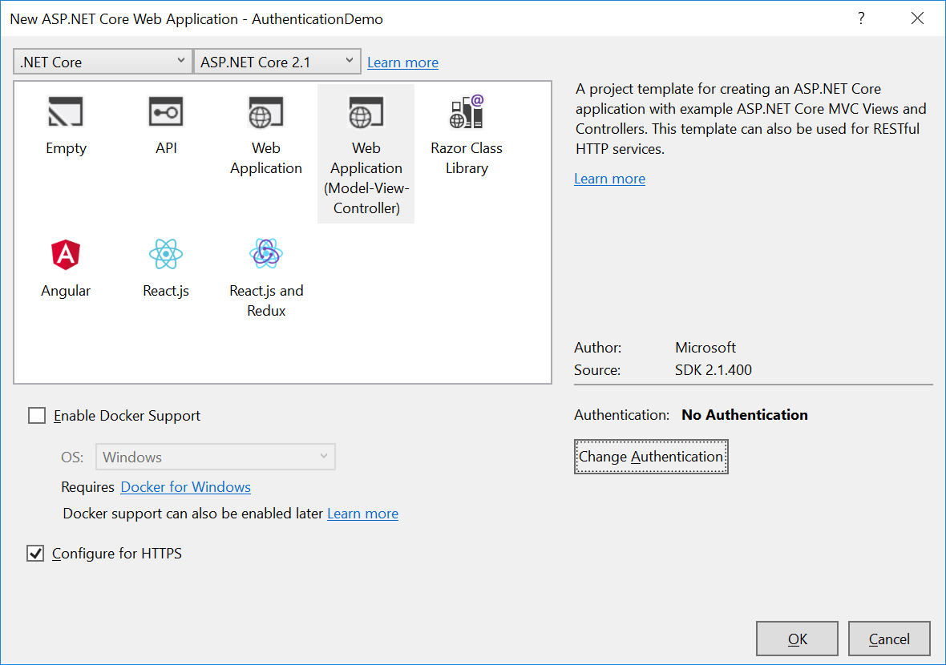
Implementation of ASP.NET Core Web Application
Changing the authentication…

Slide 6
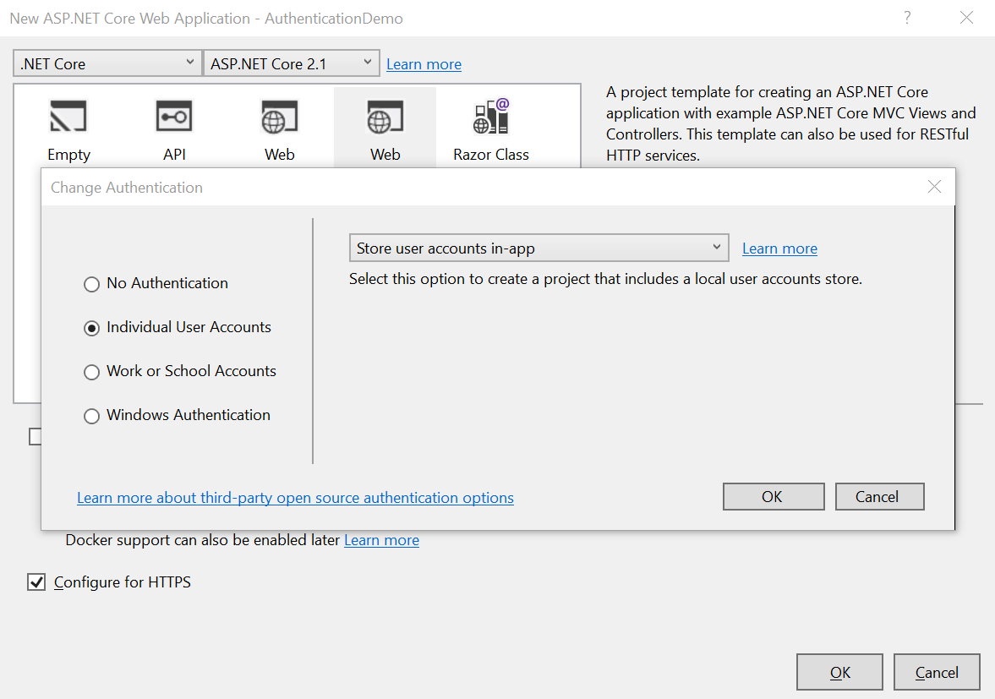
Implementation of ASP.NET Core Web Application
Changing the authentication…

Slide 7
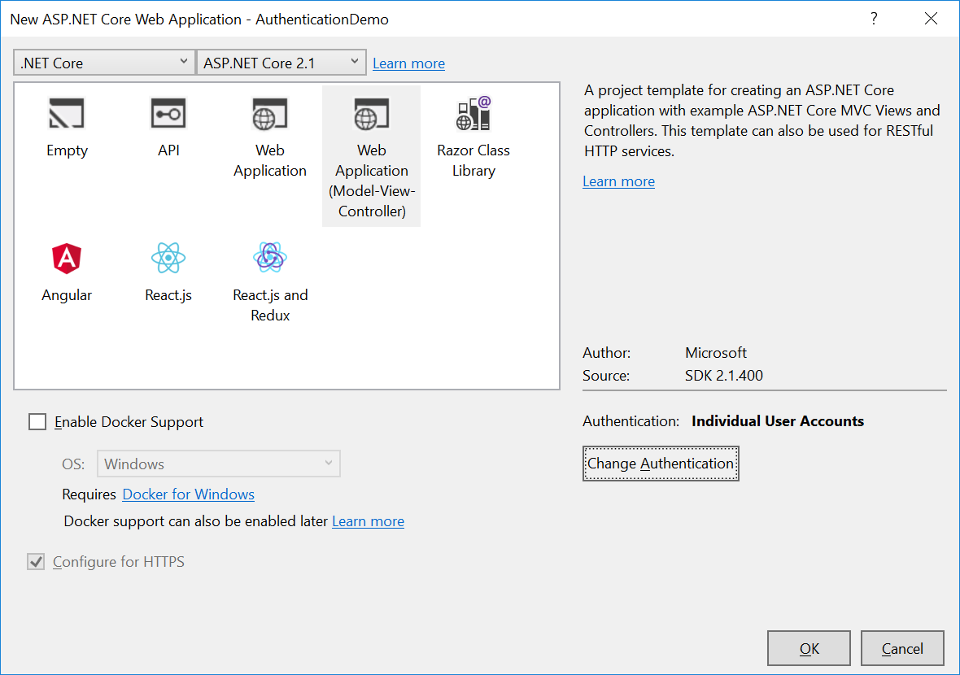
Implementation of ASP.NET Core Web Application
Changing the authentication…

Slide 8
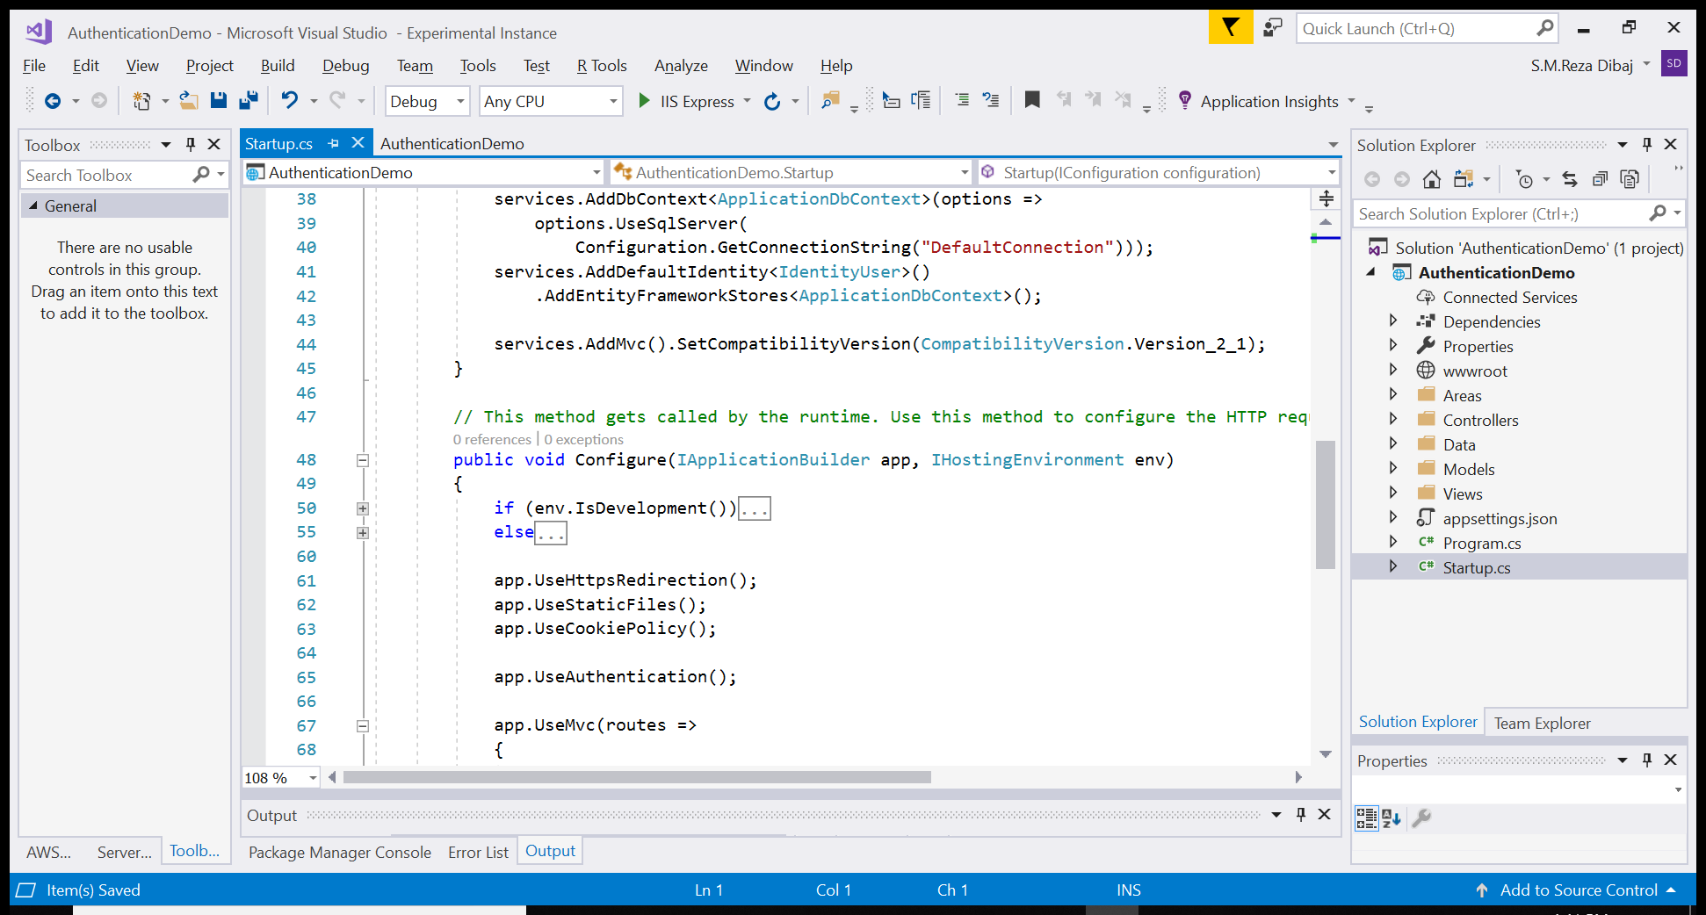
Implementation of ASP.NET Core Web Application
Changing the authentication…

Slide 9
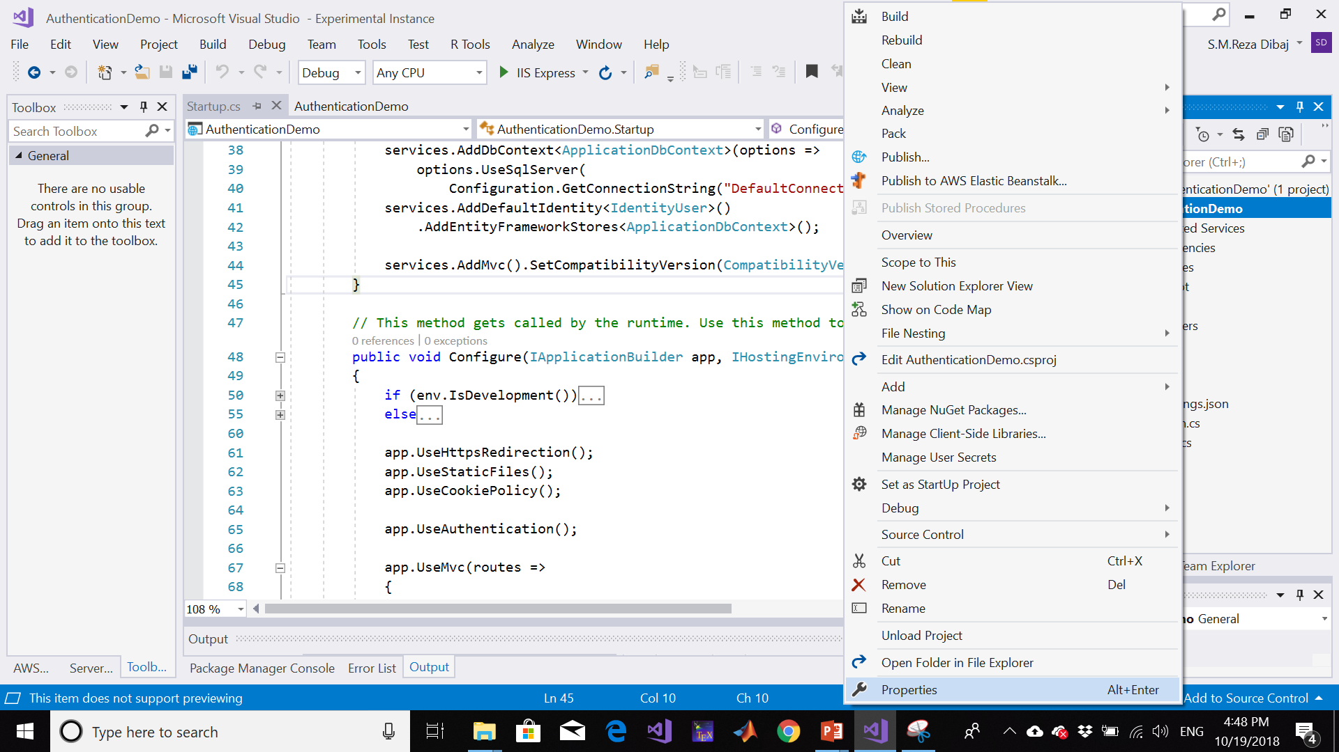
Enabling SSL
Going to the project properties…

Slide 10
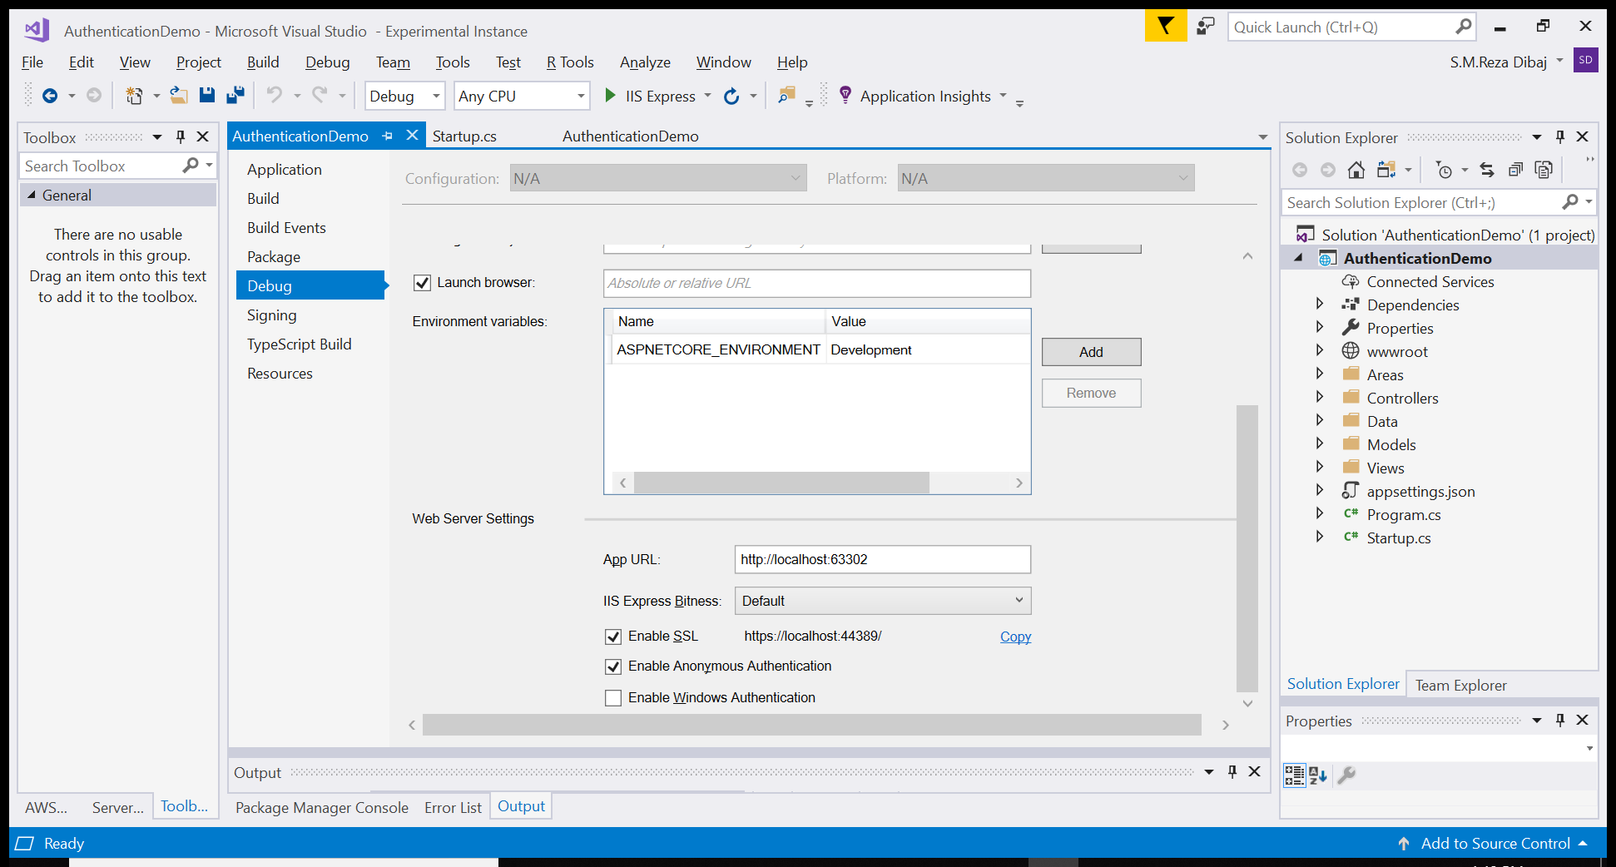
Enabling SSL
Going to the project properties…

Slide 11
Entity Framework Core Migrations
A data model changes during development and gets out of sync with the database. The migrations feature in EF Core provides a way to incrementally update the database schema to keep it in sync with the application’s data model while preserving existing data in the database.

Slide 12
Entity Framework Core Migrations
Migrations includes command-line tools and APIs to do following task:
Create migrati0n
Update the database
Customize migration code
Remove a migration
Revert a migration
Generate SQL scripts

Slide 13
Entity Framework Core Migrations
Migrations includes command-line tools and APIs to do following task:
Create migration
Add-Migration InitialCreate (PMC)
Dotnet ef migrations add InitialCreate (Console)
Update the database
Update-database (PMC)
Dotnet ef database update (console)
Customize migration code
Add-Migration ADdProductReview (PMC)
Dotnet ef migration add AddProductReview (console)
Remove a migration
Remove-migration (PMC)
Dotnet ef migration remove (console)
Revert a migration
Update-database lastgoodmigration (PMC)
Dotnet ef database update lastgoodmigration (console)
Generate SQL scripts
Script-migration (PMC)
Dotnet ef migrations script (console)

Slide 14
Creating Database
Before running the application, apply migrations to the application.
At the beginning, update the database using the Entity Framework Code Migration by using Update-Database command.

Slide 15
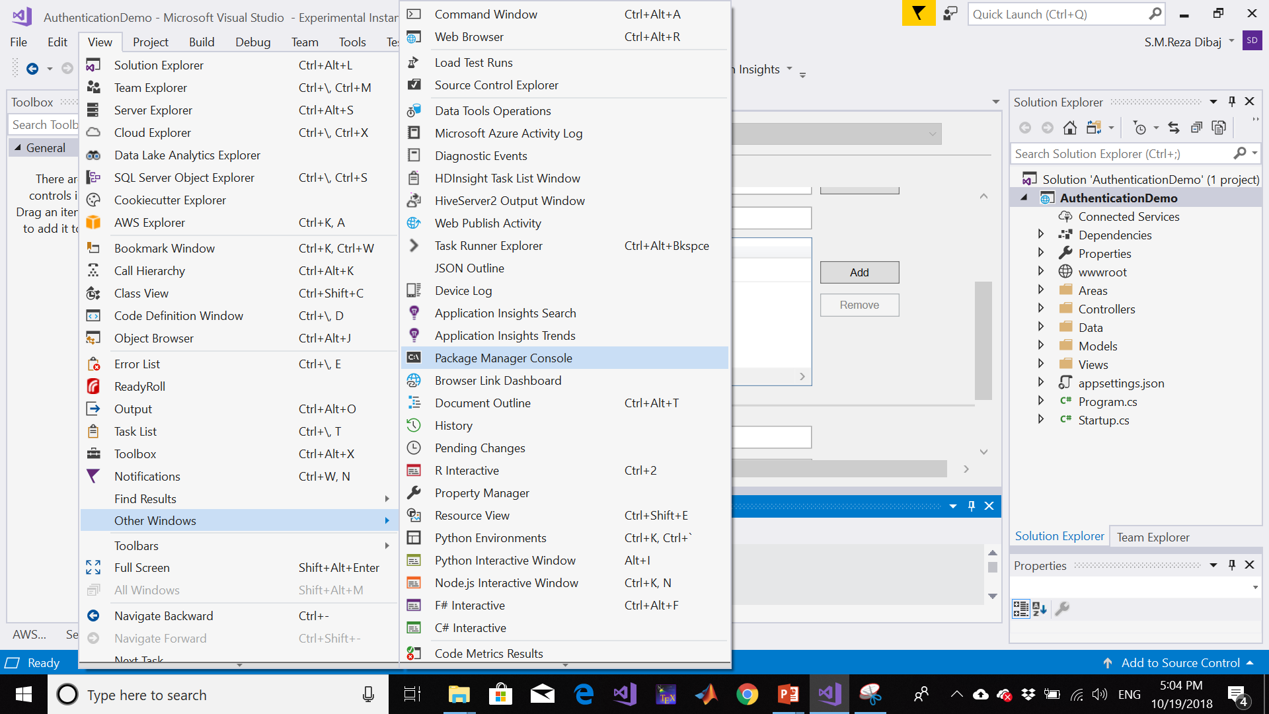
Creating Database
Going to Package Manager Console…

Slide 16
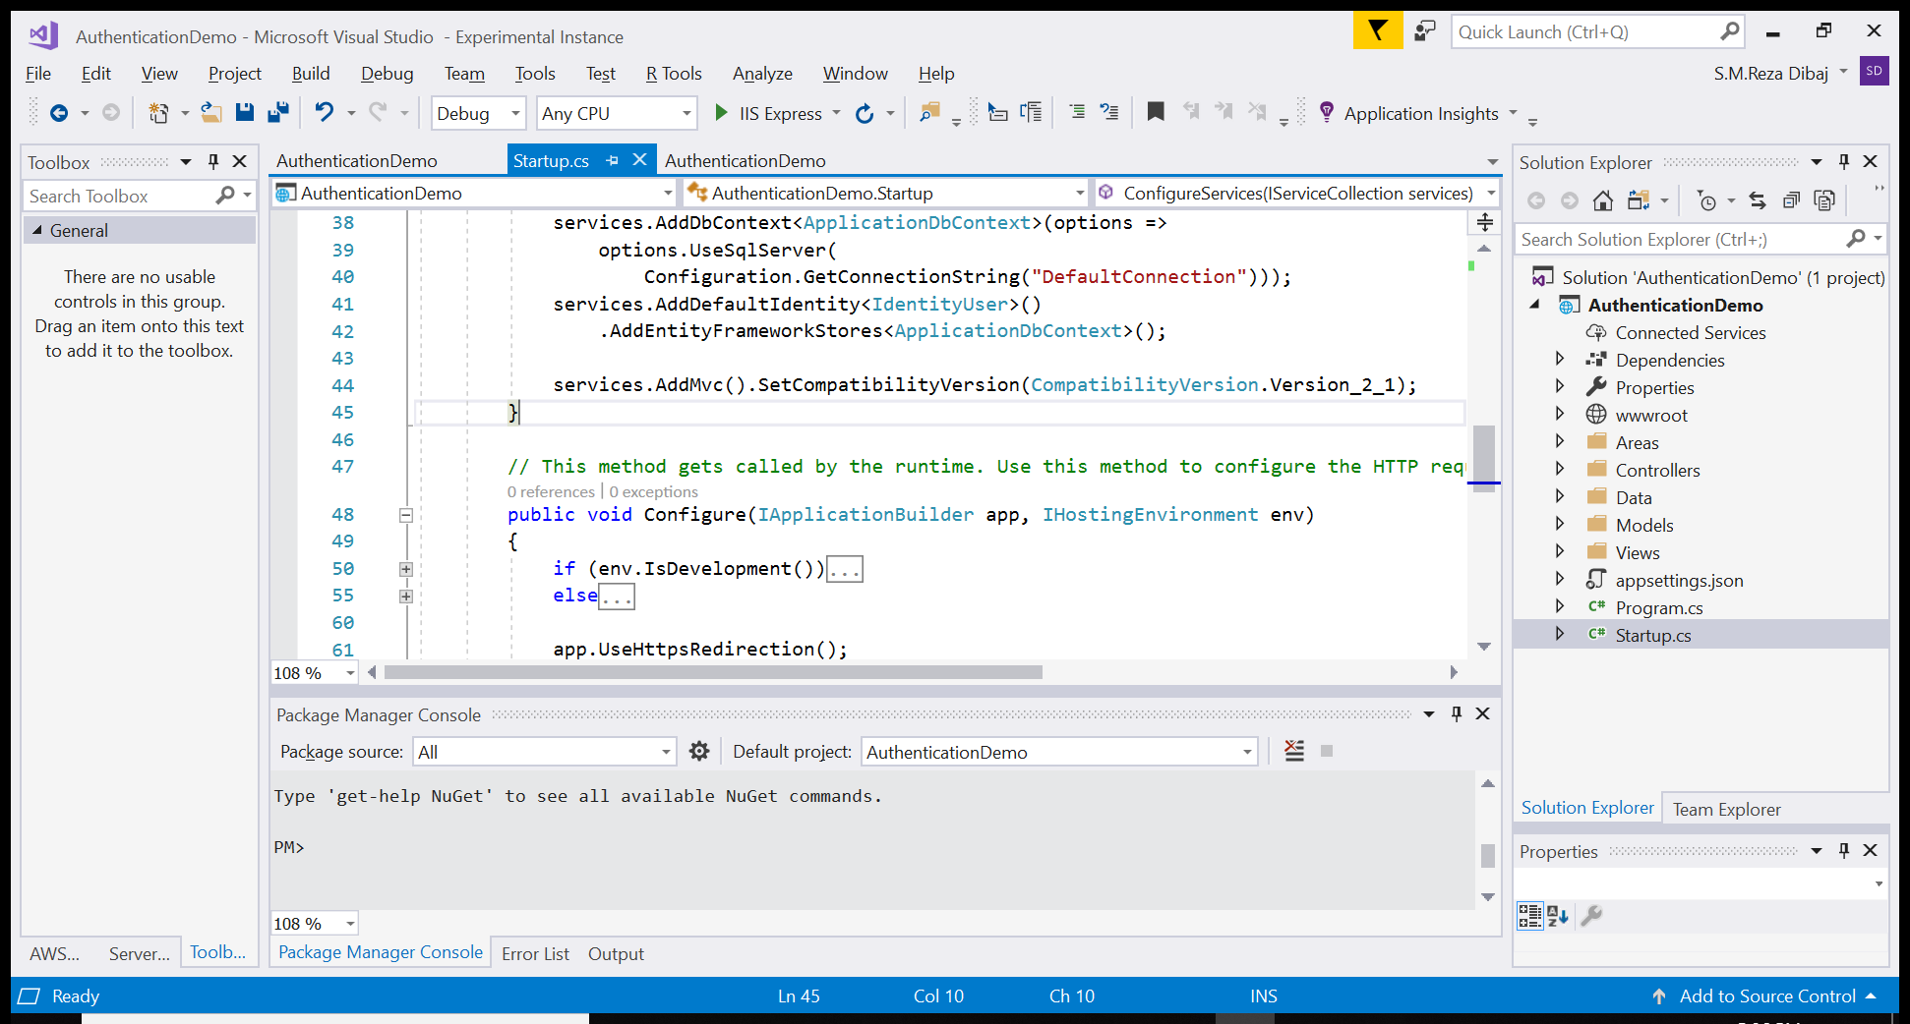
Creating Database
Going to Package Manager Console…

Slide 17
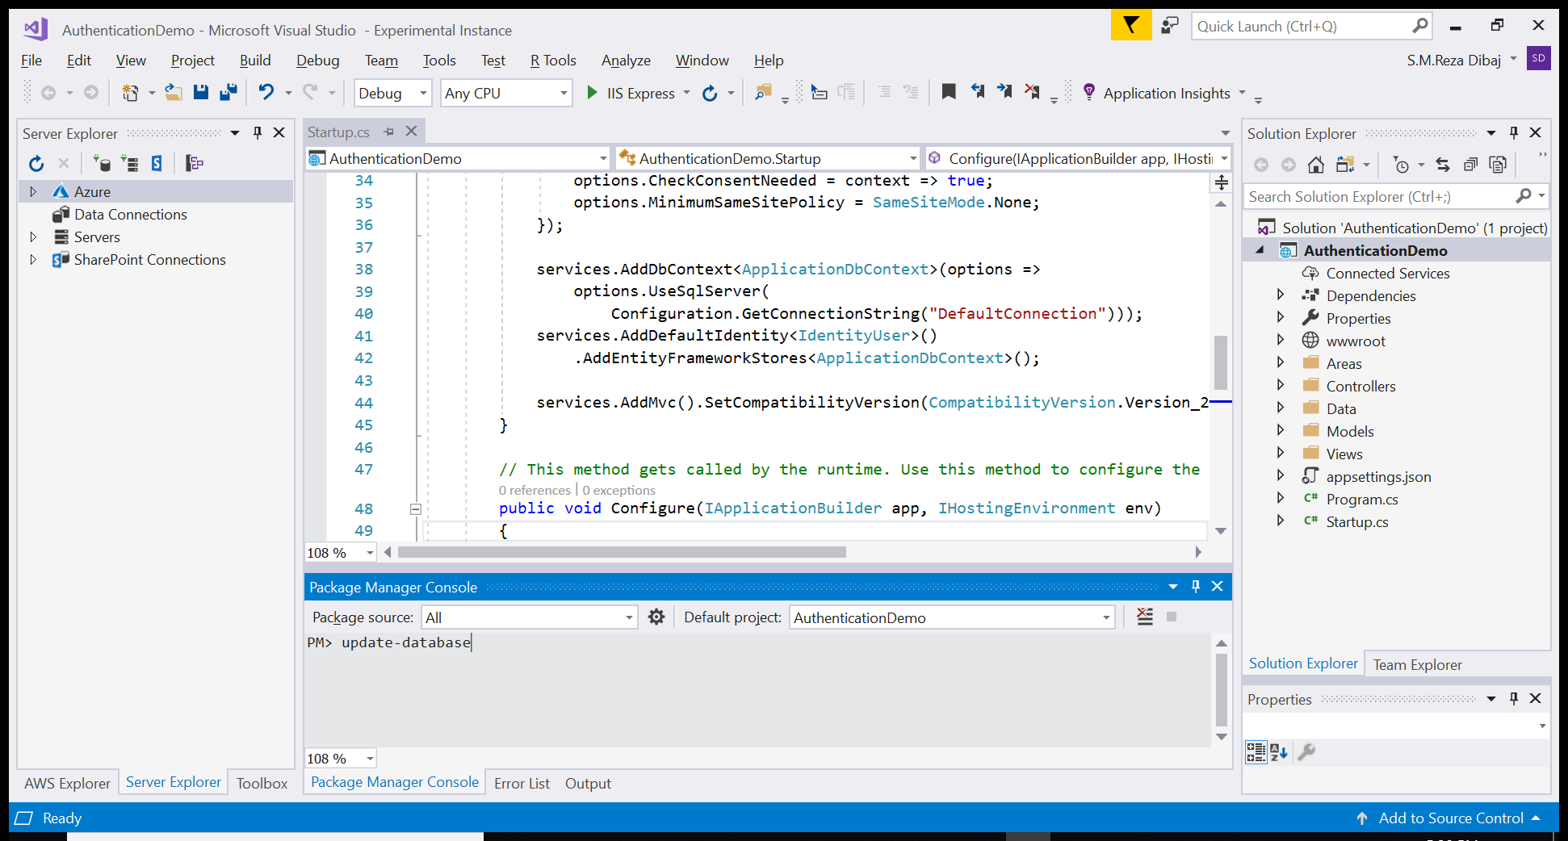
Creating Database
Updating the database….
Notes:
update-database

Slide 18
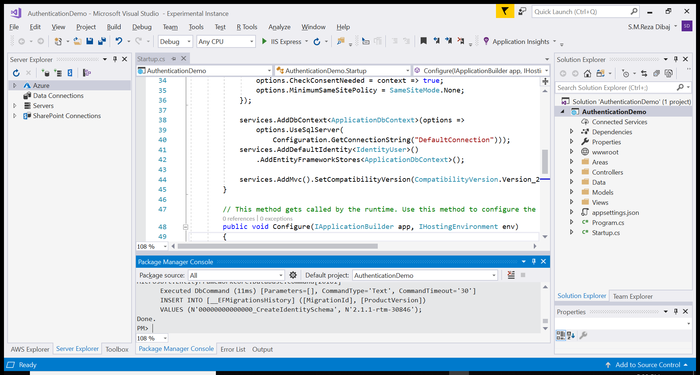
Creating Database
Updating the database…. Done!

Slide 19
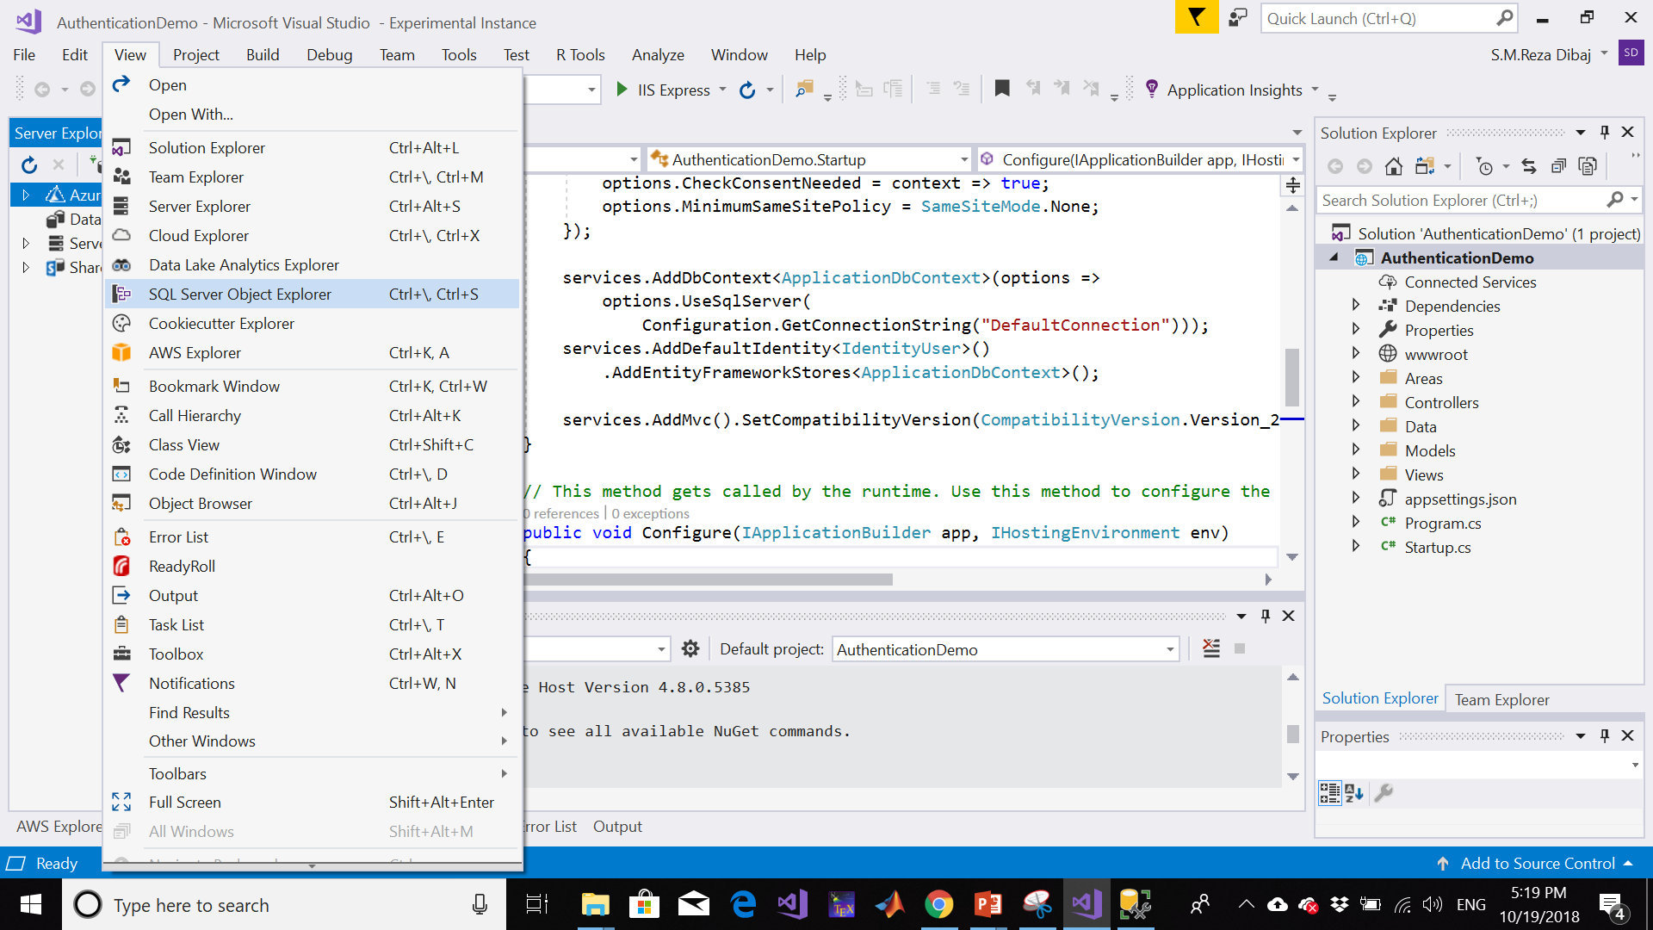
Creating Database
Bringing SQL Server Object Explorer…

Slide 20
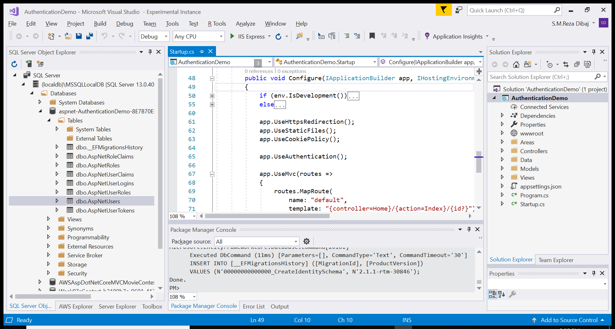
Creating Database
Bringing SQL Server Object Explorer…

Slide 21

Let’s Run!

Slide 22
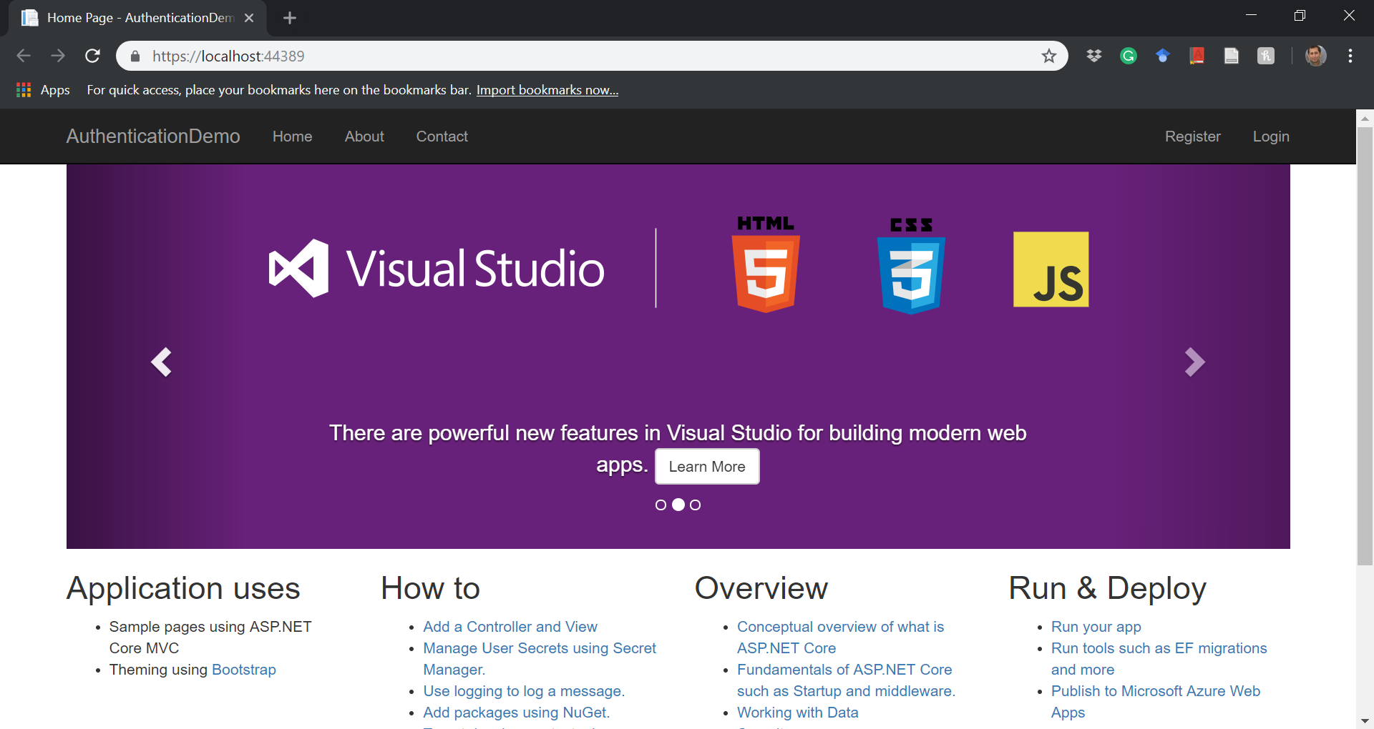
Launching the application…

Slide 23
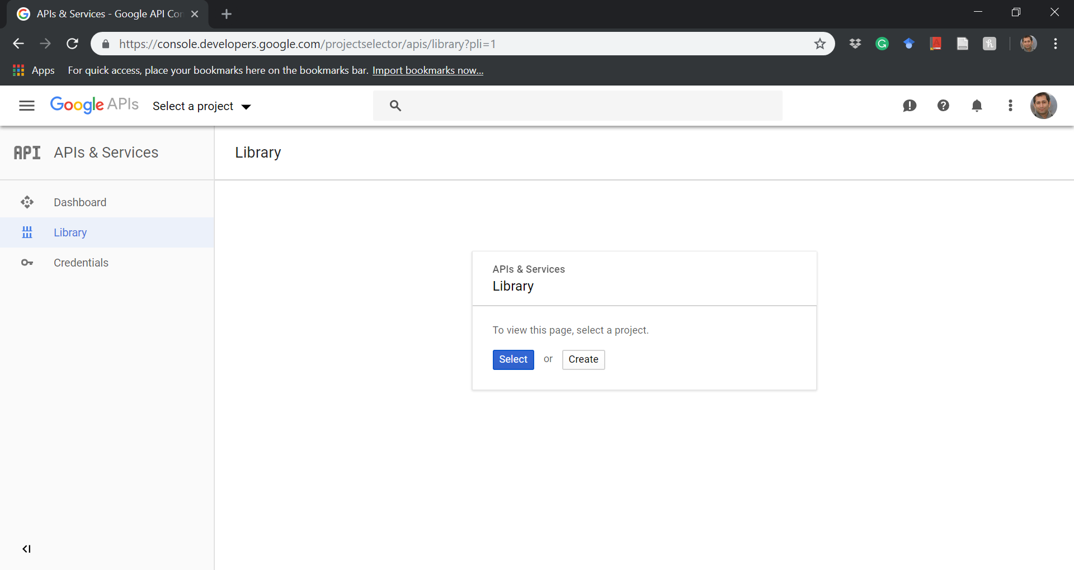
Creating a Google Application…
Please find the following link:
https://console.developers.google.com/projectselector/apis/library

Slide 24
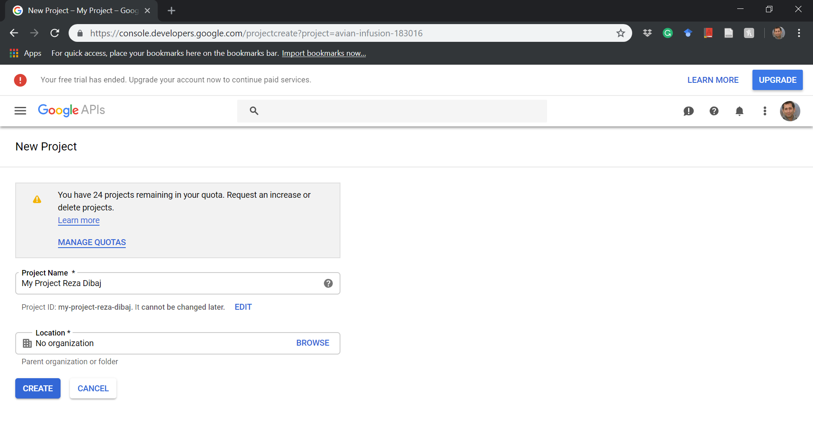
Creating a Google Application…
Create a new project by assigning an appropriate name (max 30 characters)

Slide 25
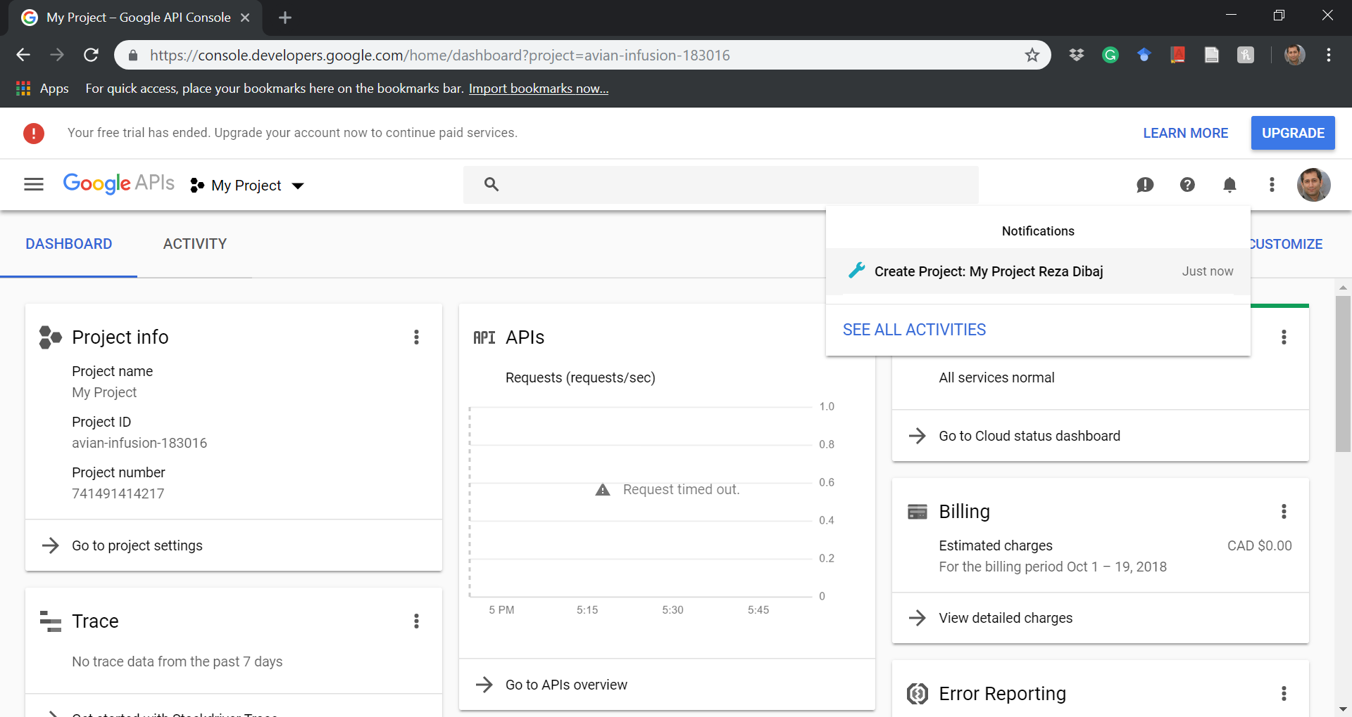
Creating a Google Application…
1
2

Slide 26
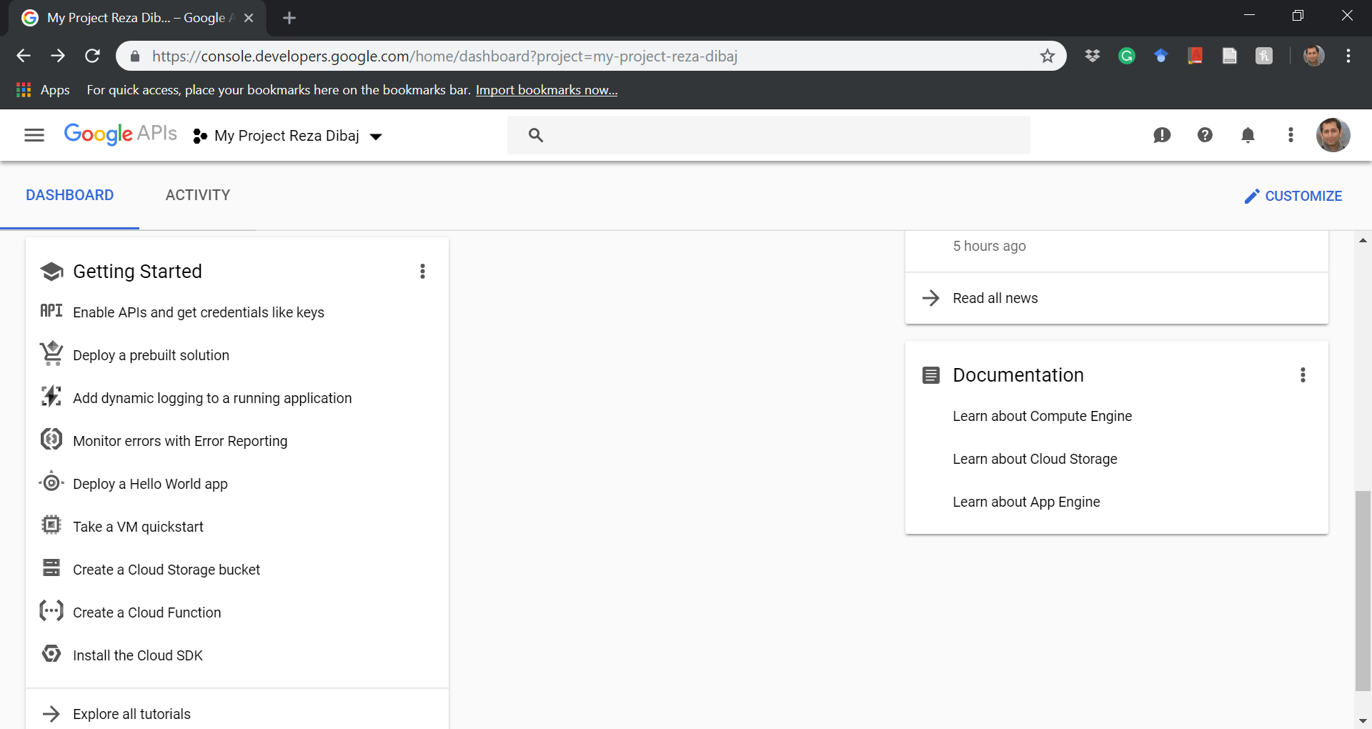
Creating a Google Application…
Going to the Enable APIs and get credentials like keys…

Slide 27
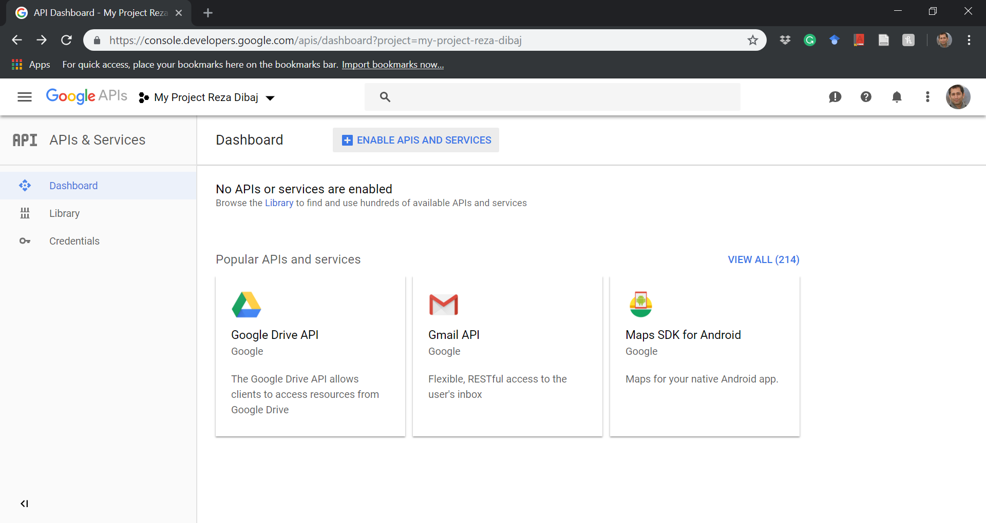
Creating a Google Application…
Going to the library…

Slide 28
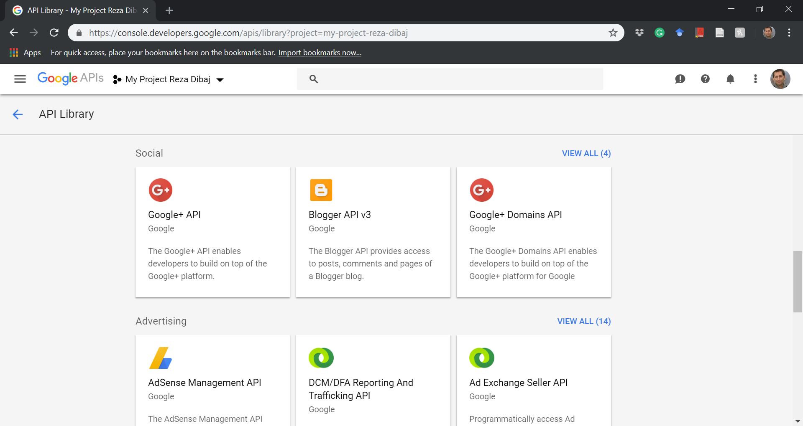
Creating a Google Application…
Going to the library…

Slide 29
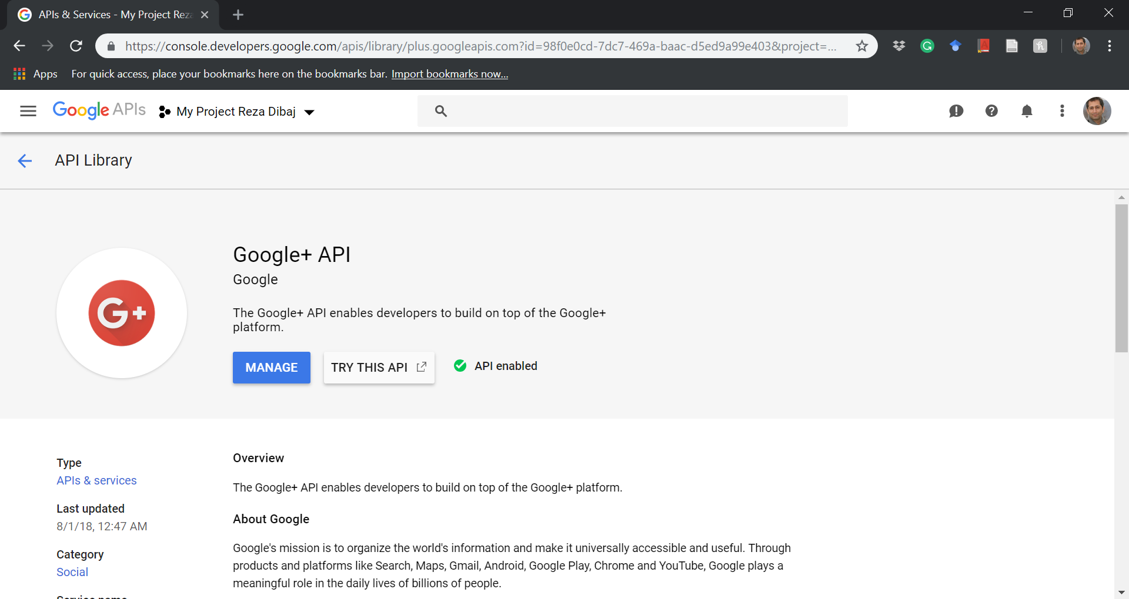
Creating a Google Application…
Click on the ENABLE button and it will change into MANAGE
Now click on the MANAGE buttion…
1
2

Slide 30
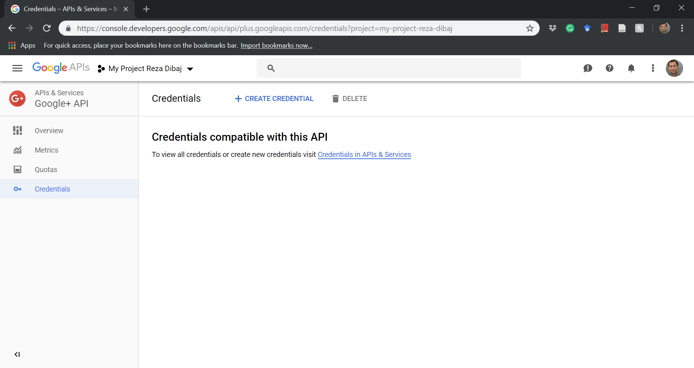
Creating a Google Application…
Now click on the Credentials, and then Create Credentials…
2
1

Slide 31
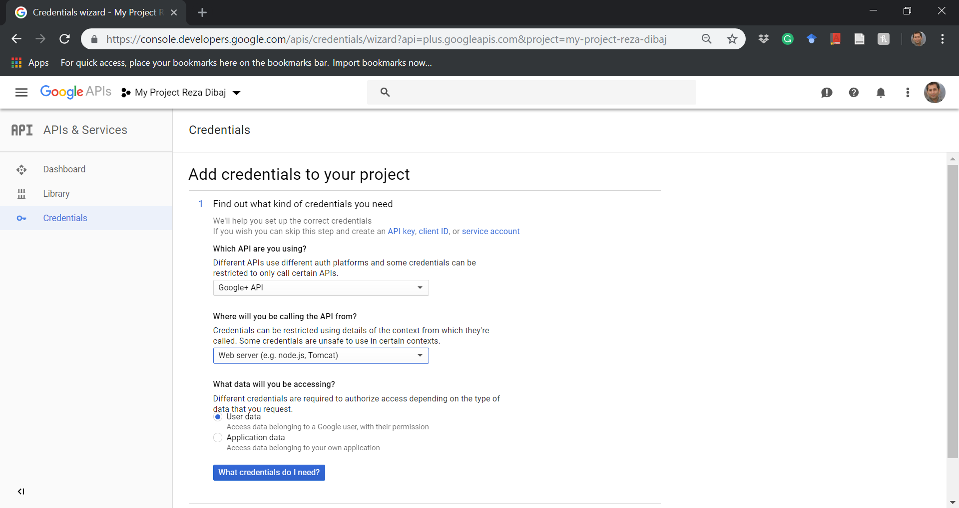
Creating a Google Application…
Change the following items….

Slide 32
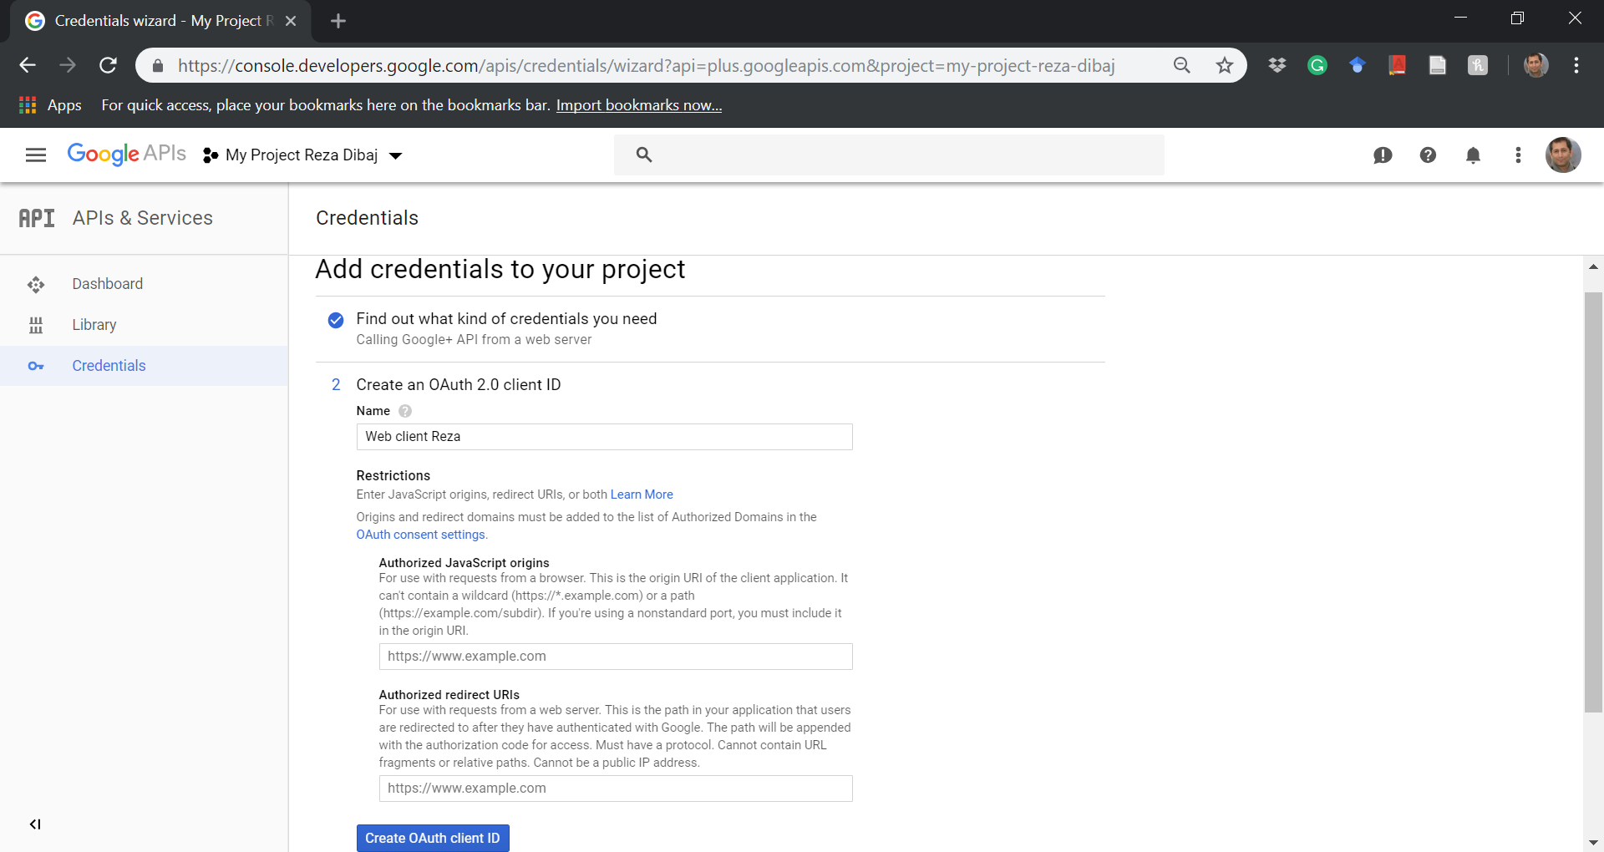

Creating a Google Application…
Change the following items….
Extremely Important:
Based on your localhost address you should use the following format inside the red rectangle:
https://[localhost address]/signin-google

Slide 33
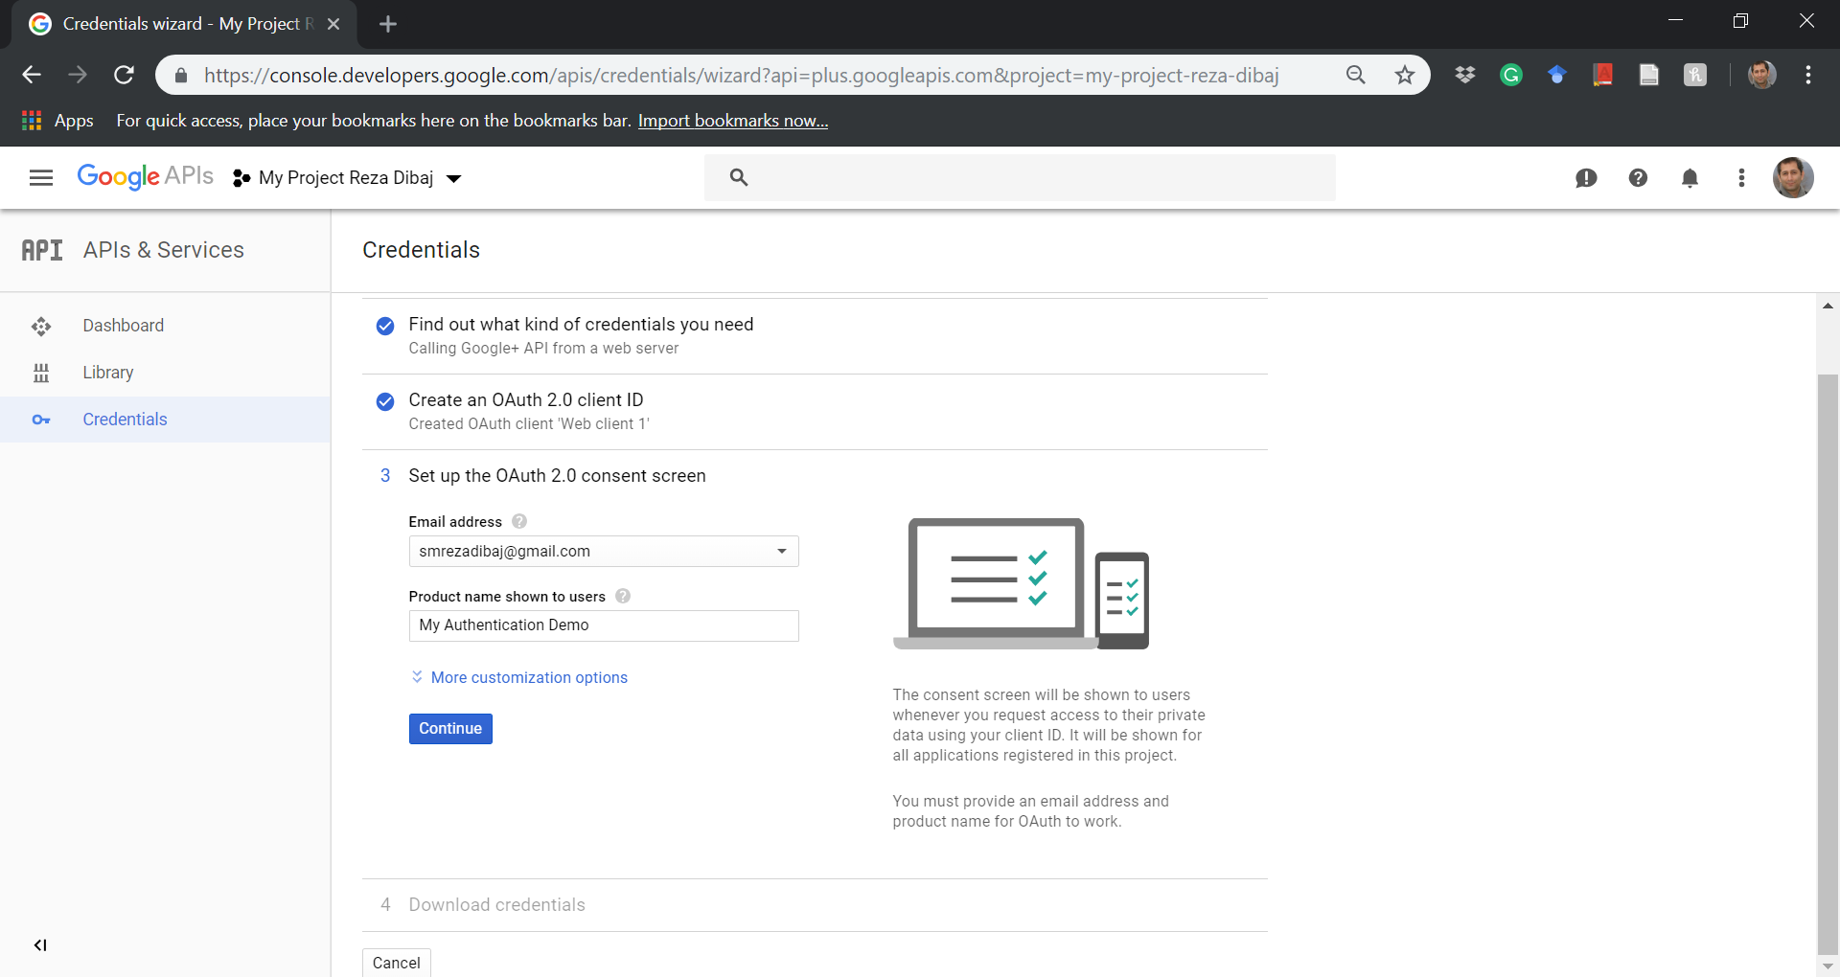
Creating a Google Application…
Change the following items….

Slide 34
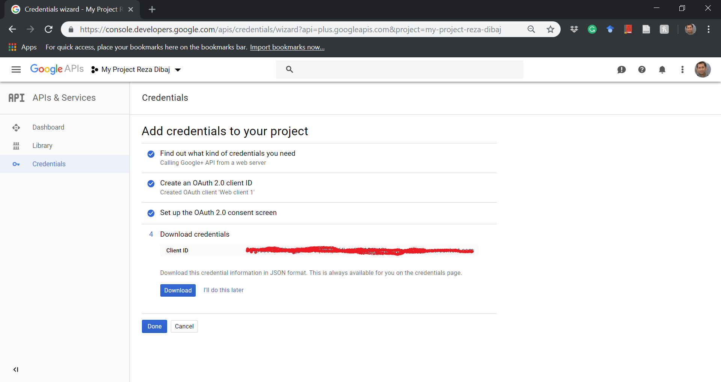
Creating a Google Application…
Change the following items….

Slide 35
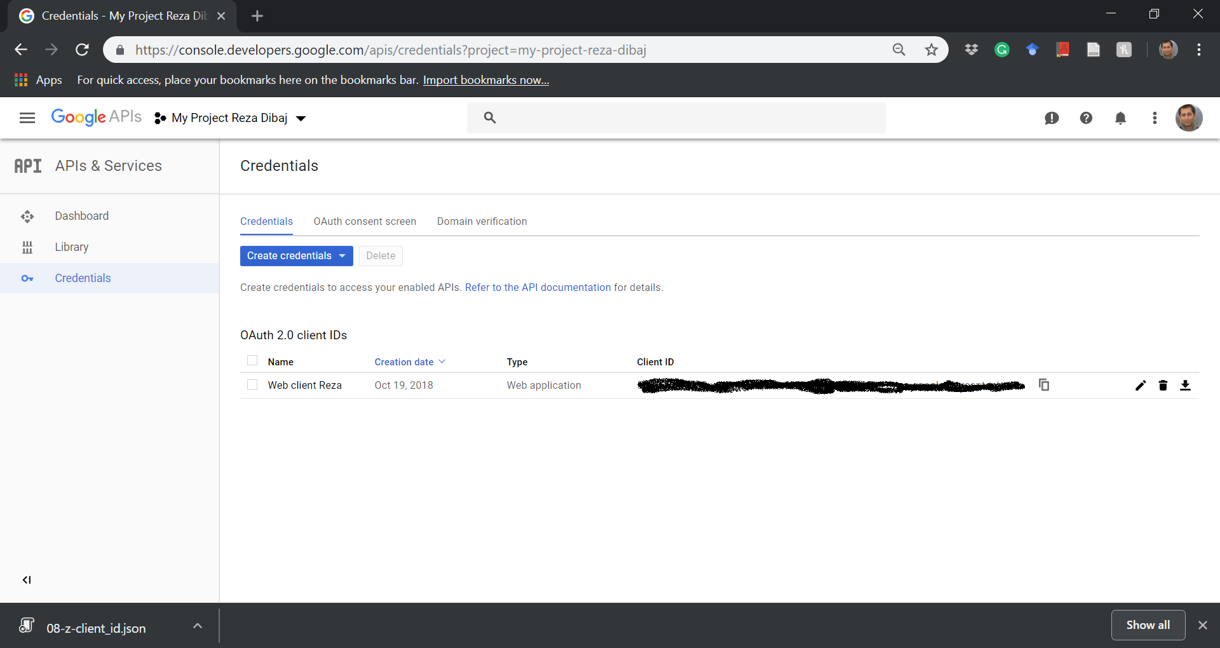
Creating a Google Application…
Saving a json file….

Slide 36
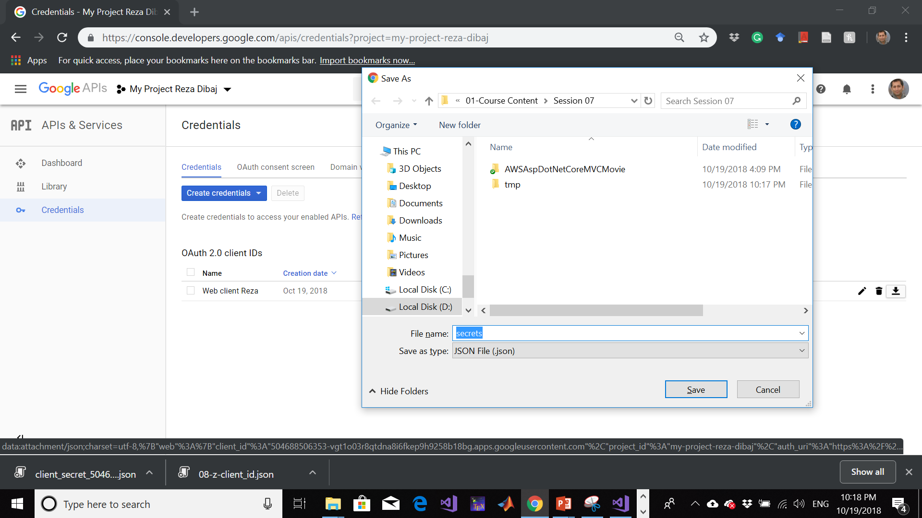
Creating a Google Application…
Change the following items….

Slide 37
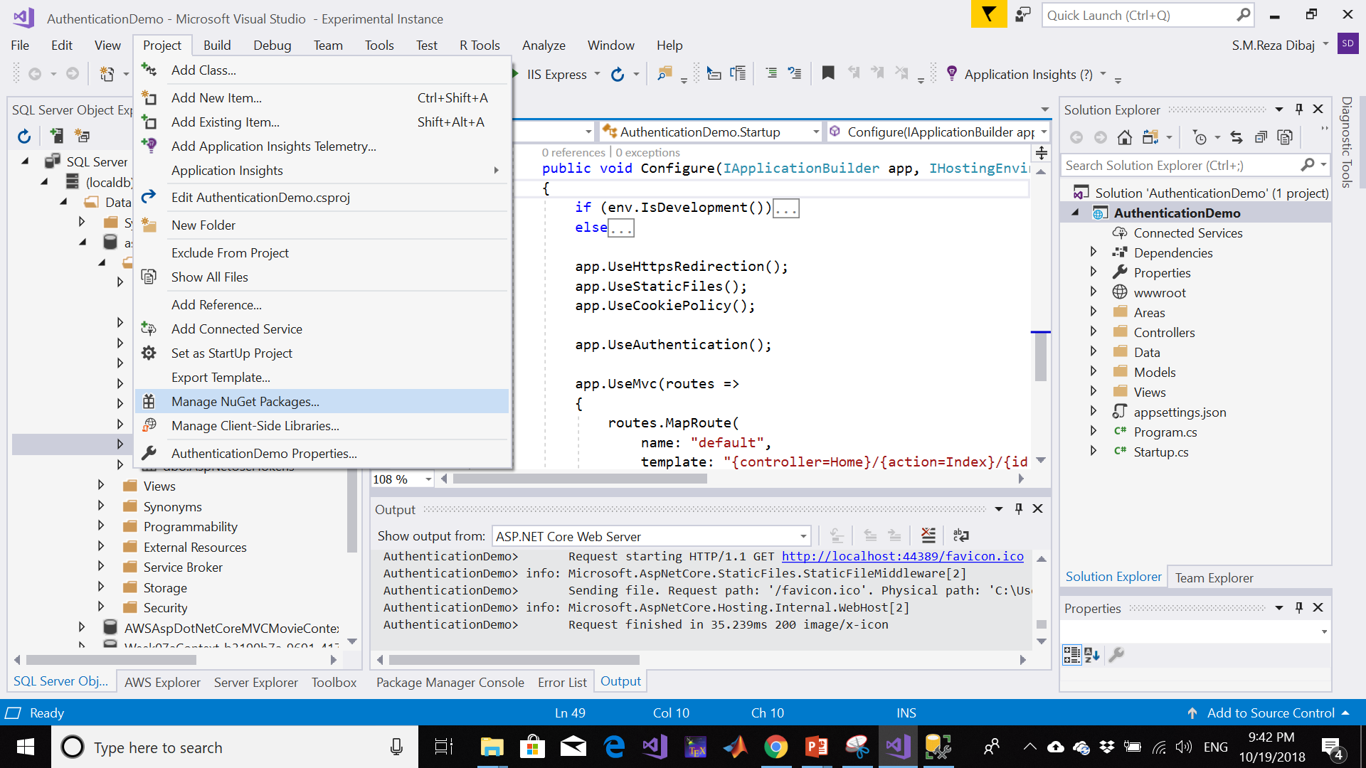
Configure Web App to Use Google Authentication
Bringing the Manage NuGet Packages…

Slide 38
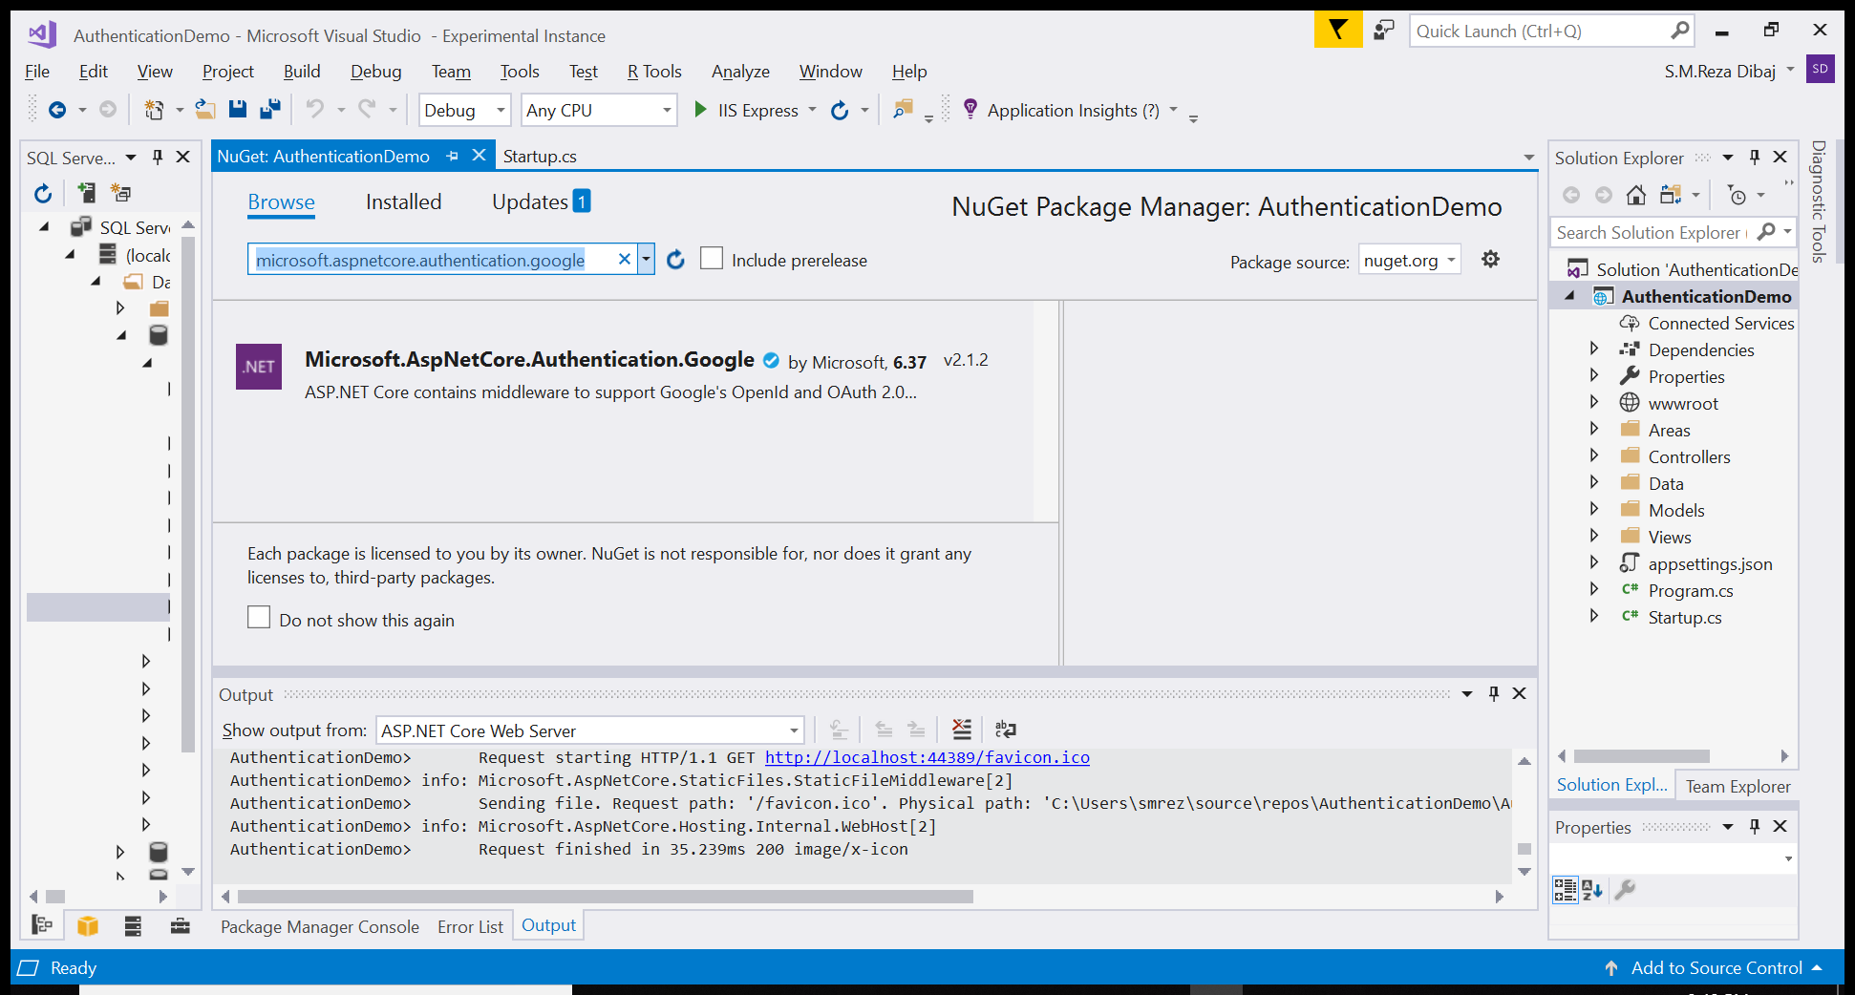
Configure Web App to Use Google Authentication
Searching for microsoft.aspnetcore.authentication.google:
Notes:
microsoft.aspnetcore.authentication.google

Slide 39
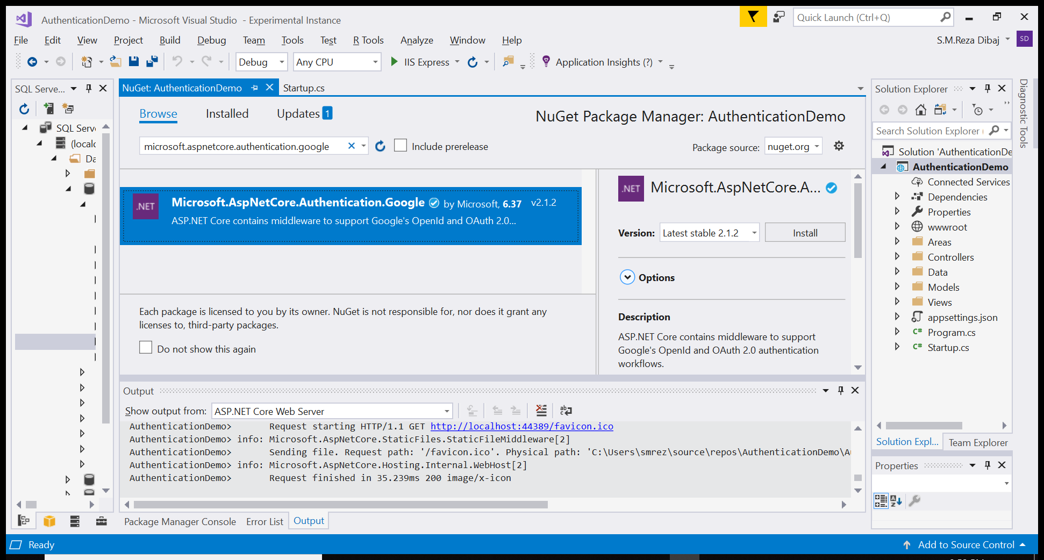
Configure Web App to Use Google Authentication
Searching for microsoft.aspnetcore.authentication.google:

Slide 40
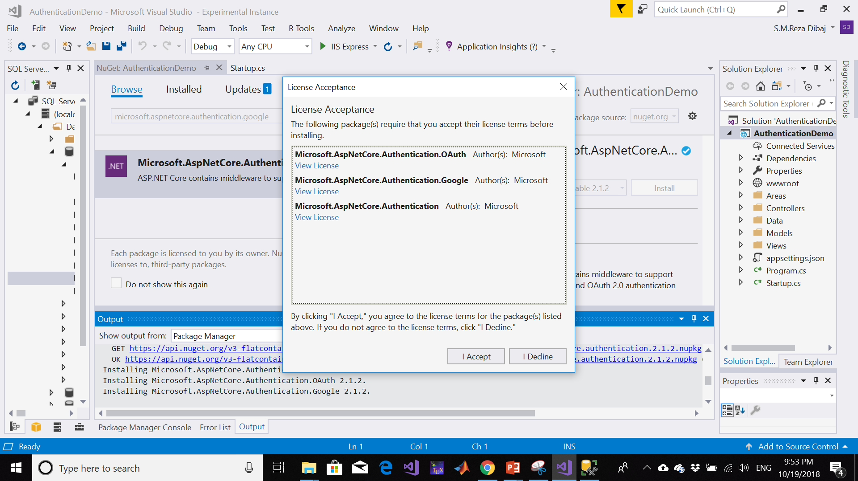
Configure Web App to Use Google Authentication
Pressing the accept button…

Slide 41
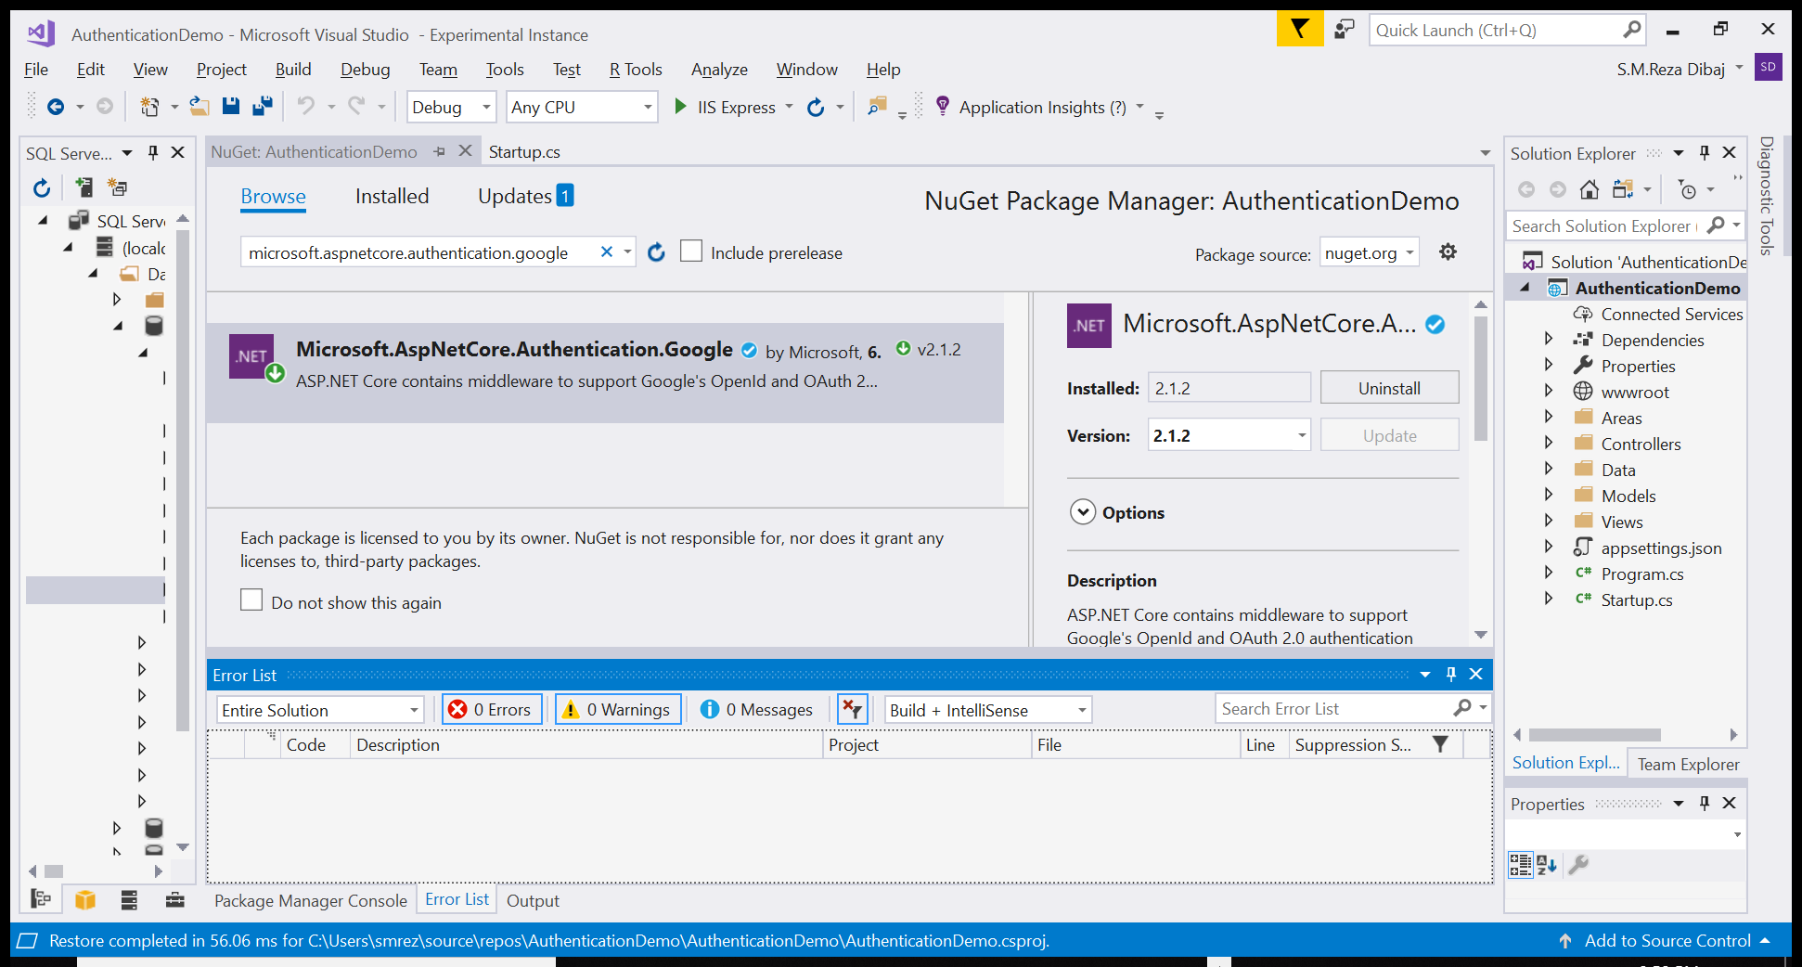
Configure Web App to Use Google Authentication
After installing…

Slide 42
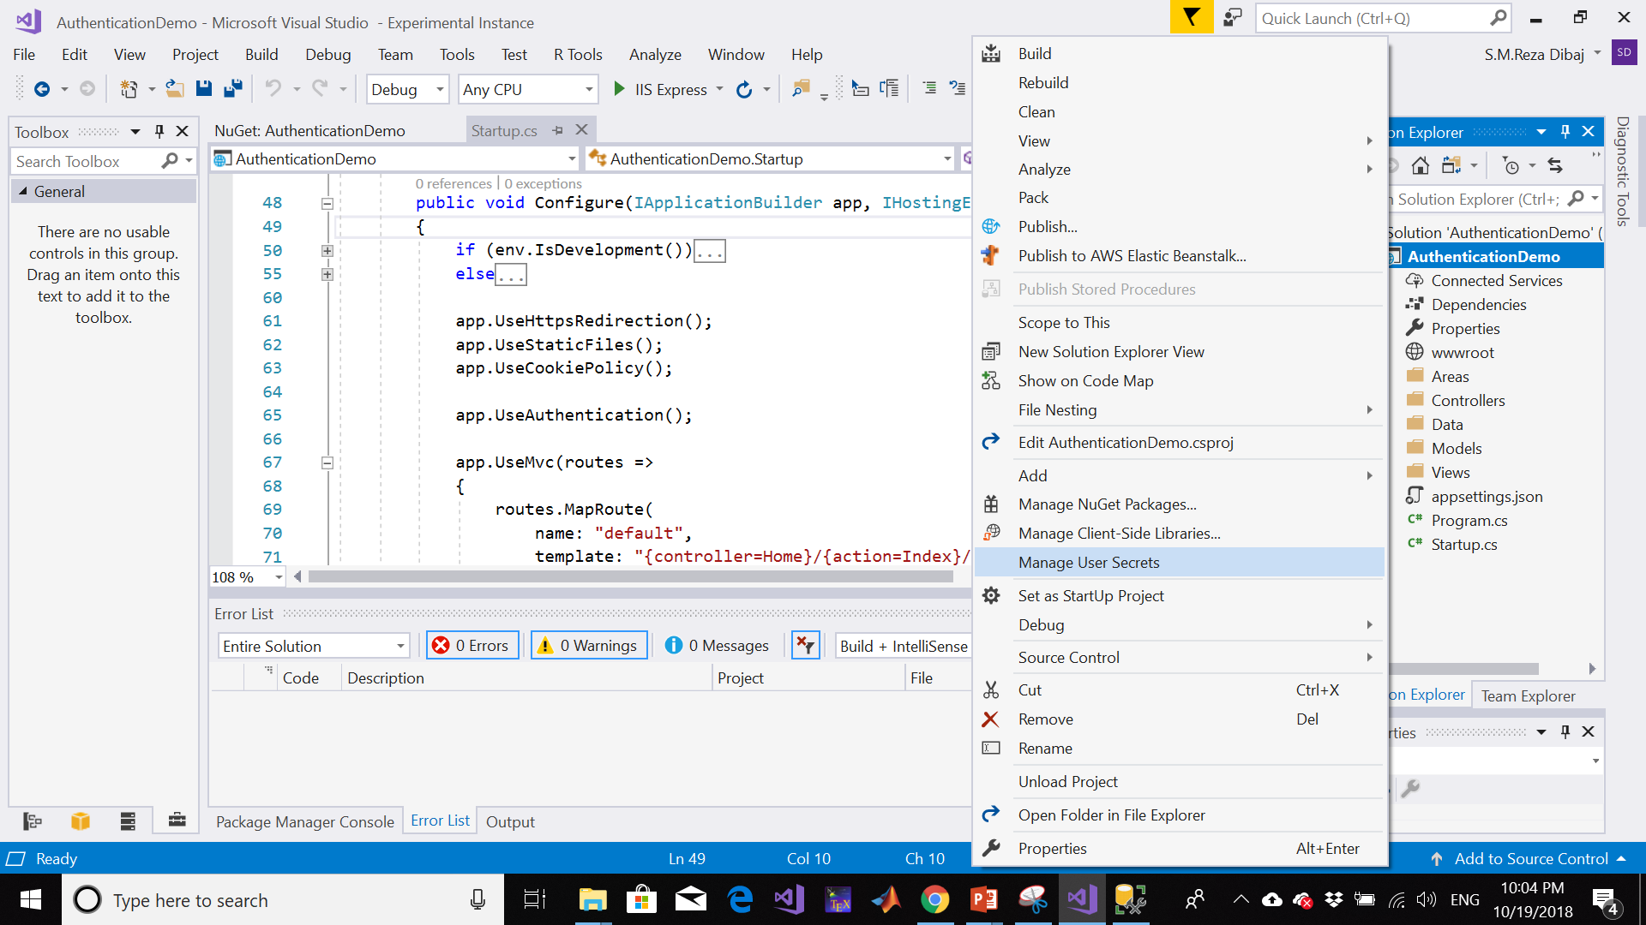
Configure Web App to Use Google Authentication
Right click on the project and choose Manage User Secrets…

Slide 43
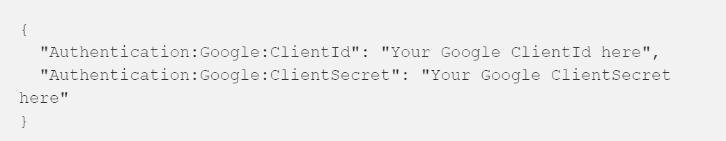
Configure Web App to Use Google Authentication
A secrets.json file will open. Put the following code in it:
Notes:
{
"Authentication:Google:ClientID": “************",
"Authentication:Google:ClientSecret": “************"
}

Slide 44
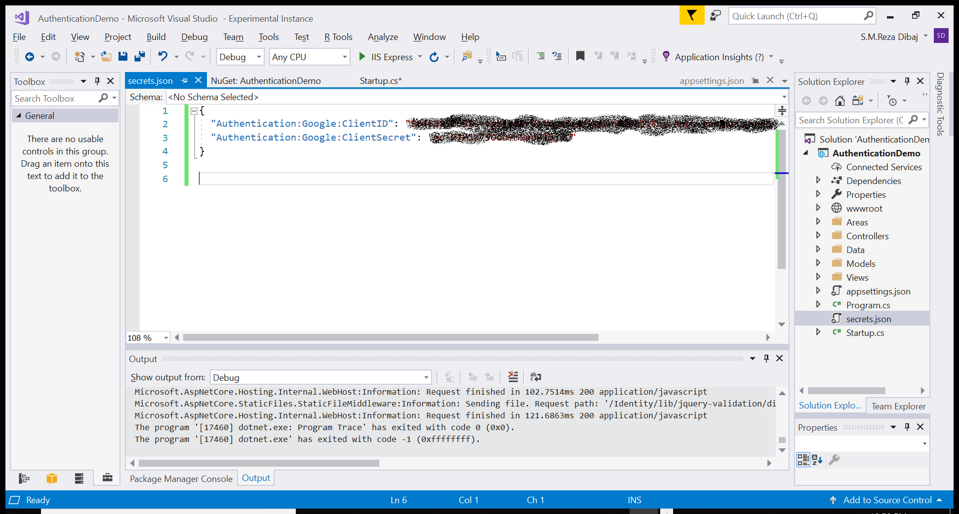
Configure Web App to Use Google Authentication
A secrets.json file will open. Put the following code in it:
Notes:
{
"Authentication:Google:ClientID": “************",
"Authentication:Google:ClientSecret": “************"
}

Slide 45
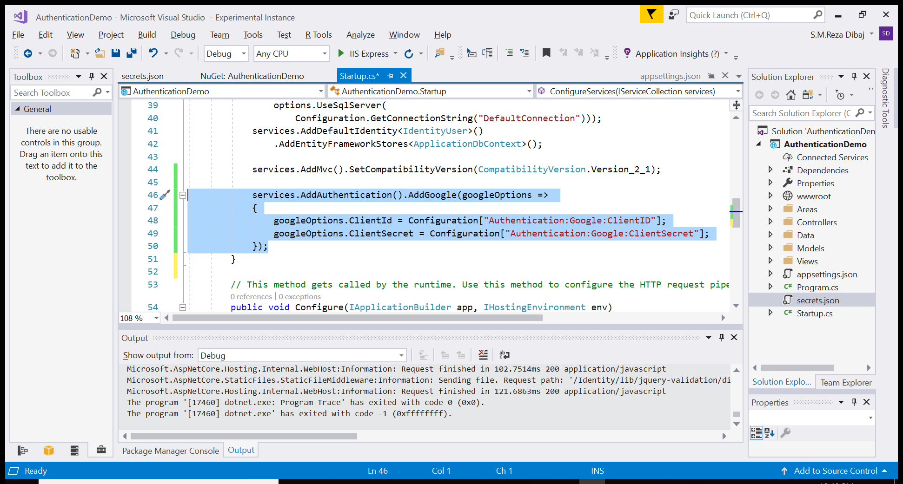
Configure Web App to Use Google Authentication
We need to add the following lines into Startup.cs:
Notes:
services.AddAuthentication().AddGoogle(googleOptions =>
{
googleOptions.ClientId = Configuration["Authentication:Google:ClientID"];
googleOptions.ClientSecret = Configuration["Authentication:Google:ClientSecret"];
});

Slide 46
Let’s Run!

Slide 47
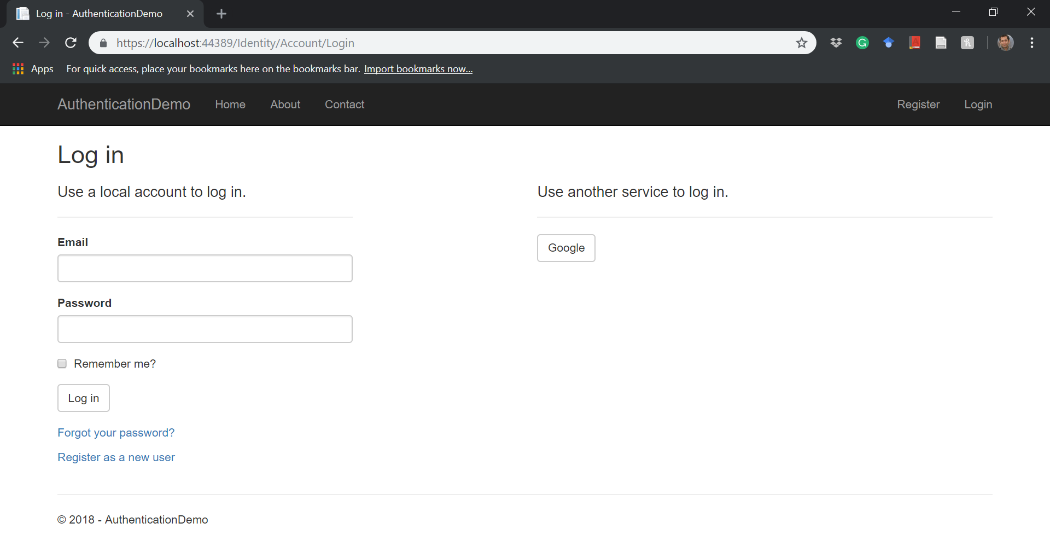
Running the Application
Now run the application and go to the Login tab…

Slide 48
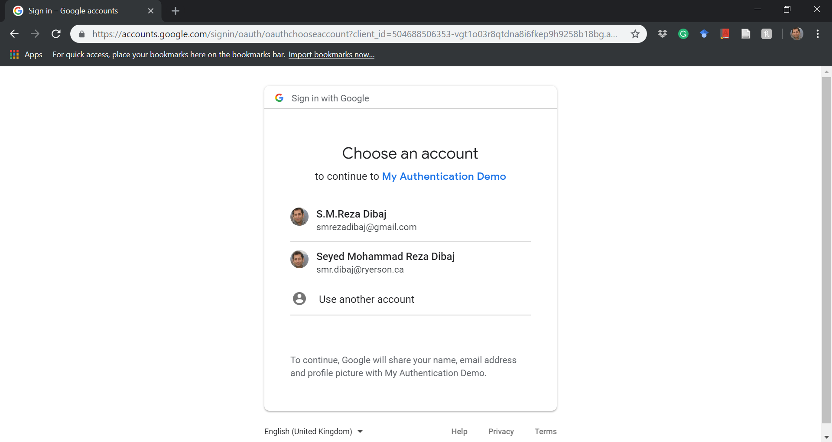
Running the Application
Yaaaaaaaay!

Slide 49
Reference
https://medium.freecodecamp.org/authentication-using-google-in-asp-net-core-2-0-5ec32c803e23

Slide 50
Thank you

